Slide 1
Module-4
Authentication Protocols
&
Digital Signature Schemes

Slide 2
Digital signature
A signature on a document, when verified, is a sign of authentication which means the document is authentic
An electronic signature can prove the authenticity of the sender of the message
This type of signature is known as Digital Signature

Slide 3
Conventional Vs Digital signature
 | Conventional | Digital
Inclusion | It is included in the document | The signature is a separate document
Verification Method | Signature on the document is compared with the signature on the file | Signature is not stored anywhere so to verify it, the recipient needs to apply a verification technique to the combination of message and signature

Slide 4
Conventional Vs Digital signature
 | Conventional | Digital
Relationship | One to many | One-to-One
Duplicity | A copy of the signed document can be distinguished from the original one in a file | There is no such distinction Attack: Interception, Replay

Slide 5
Digital signature: Process
The sender uses a signing algorithm to sign the message
The message and the signature is sent to the receiver
The receiver receives the message and the signature and applies the verifying algorithm to the combination
If the result is true, then the message is accepted else it is rejected

Slide 6
Process
Need for keys
Signing the Digest

Slide 7
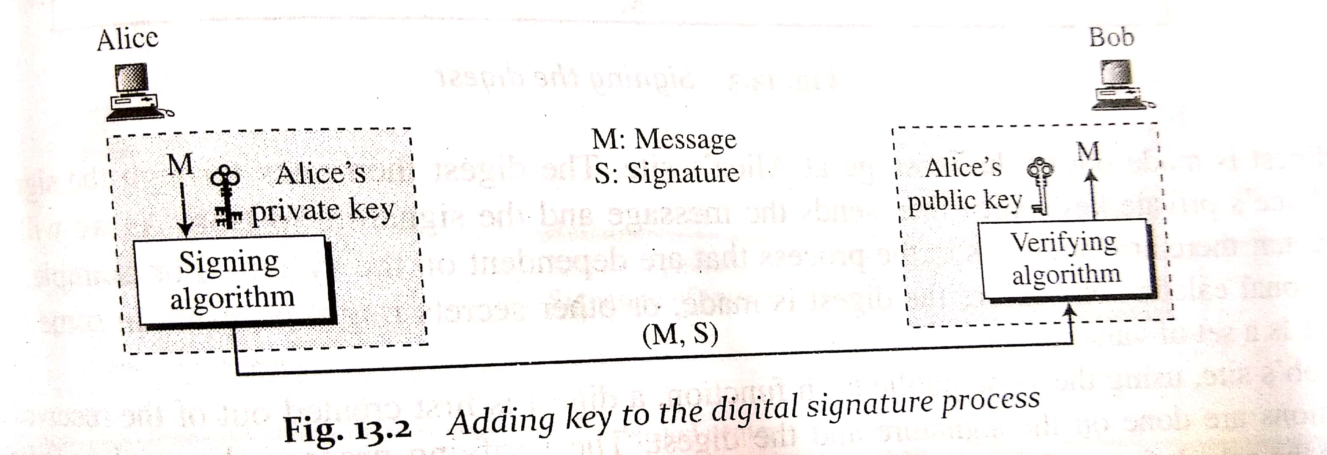
Need for keys
The sender uses its private key to sign the document
The receiver uses the public key of the sender to verify the document

Slide 8
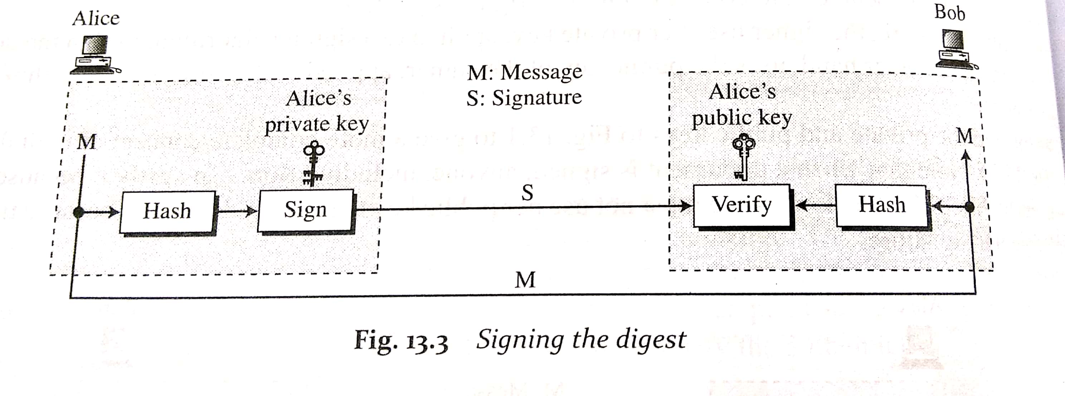
Signing the digest
Asymmetric key encryption are inefficient when dealing with long messages
In digital signature system, the messages are generally very long
So, the solution is to sign a digest of the message which is much shorter than the message

Slide 9
Signing the digest
At the sender’s side, the message digest is created
The digest then goes through the signing process using the sender’s private key
The message and the signature is sent
At receiver’s side, the digest is created for the received message using the same hash function
Calculations are done on the signature and the digest
The verification process applies criteria on the result of the calculation to determine authenticity of the signature
If authentic, the message is accepted, else it is rejected

Slide 10
Services of digital signature
Message Authentication
Message Integrity
Nonrepudiation
Confidentiality

Slide 11
Message Authentication
Bob can verify that the message is sent by Alice because Alice’s public key is used in verification
How?
Assume that Eve is an attacker in the channel between Alice and Bob
Both Alice and Bob are unaware of Eve’s presence
If Eve is sending some message to Bob,
At first, the message digest is created from the message.
Secondly, the digest needs to be signed by Eve’s private key.
Then the message along with the signature is sent to Bob
Bob receives both the message and signature

Slide 12
Message Authentication (contd.)
He needs to verify the signature
Since Bob wants to make communication only with Alice, he has the public key of Alice only
So, assuming that the message which received is coming from Alice, he will try to verify it with the public key of Alice
But the public key of Alice can’t verify the signature signed by Eve’s private key.
Hence, Bob comes to know that the message is not coming from an authenticated source

Slide 13
Message Integrity
Integrity of the message is preserved even after signing. This is because we cannot get the same signature if the message is changed.
How?
The digital signature scheme uses a hash function in the signing and verifying algorithms to preserve the integrity of the message

Slide 14
Nonrepudiation
If Alice sends a message and then denies it, then Bob can prove that Alice actually signed it.
How?
If Alice sends a message to Bob asking him to transfer Rs. 50,000 to Eve
Bob transfers the amount.
Alice later denies that she has sent this message. (Problem)

Slide 15
Nonrepudiation
Possible Solution:-
Bob must keep the signature in a file and use the public key of Alice to create the original message.
Then he has to prove that the new message created is same as the original message.
Then only Alice will accept.

Slide 16
Nonrepudiation
Problem:-
This solution is infeasible because Alice might have changed her public or private key.
She might claim that the file containing the signature is not authentic.
The proper solution is to use services of the trusted third party
People can create an established trusted party among themselves.

Slide 17
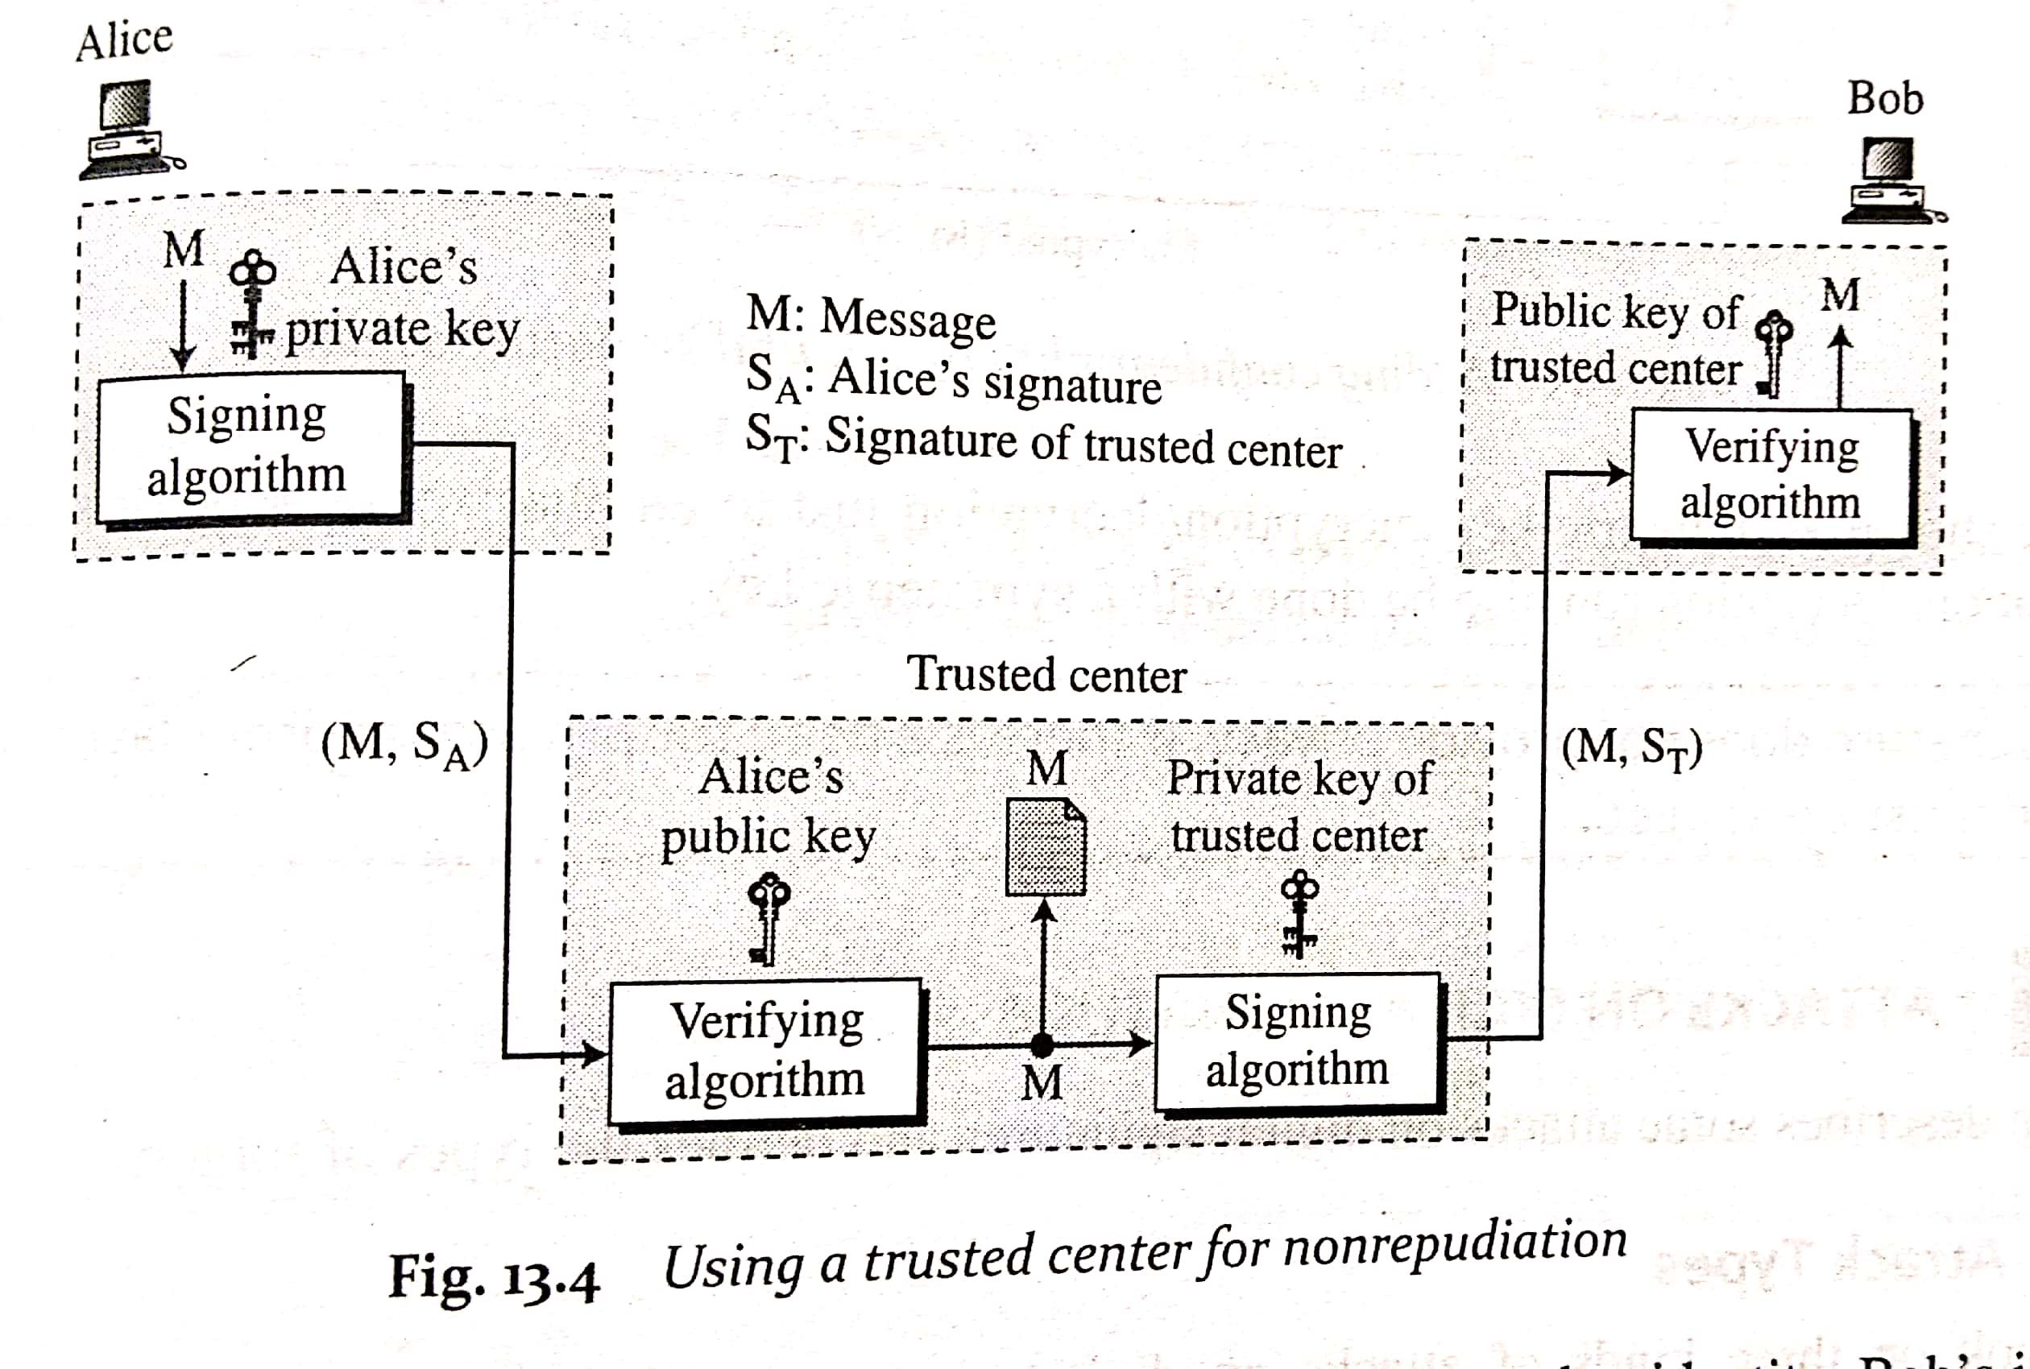
Nonrepudiation

Slide 18
Nonrepudiation
Alice creates a signature from her message (S_{A}) and sends the message, the signature, her identity and Bob’s identity to the center
The center, after checking the validity of Alice’s public key, verifies through the same key that the message came from Alice.
The center saves a copy of message with the sender’s identity, recipient’s identity and a timestamp in its archive
The sender uses its private key to create another signature (S_{R} ) from the message

Slide 19
Nonrepudiation
The center sends the following to Bob: message, the new signature, Alice’s identity and Bob’s identity
Bob verifies the message using public key of the trusted center
If in future, if Alice denies sending the message then the center can show a copy of the saved message

Slide 20
Confidentiality
Digital signature scheme does not provide privacy or confidentiality.
But if privacy/confidentiality is required then it can be provided
How?
Using another layer of encryption/decryption
The message and the signature must be encrypted using either symmetric or asymmetric communication

Slide 21
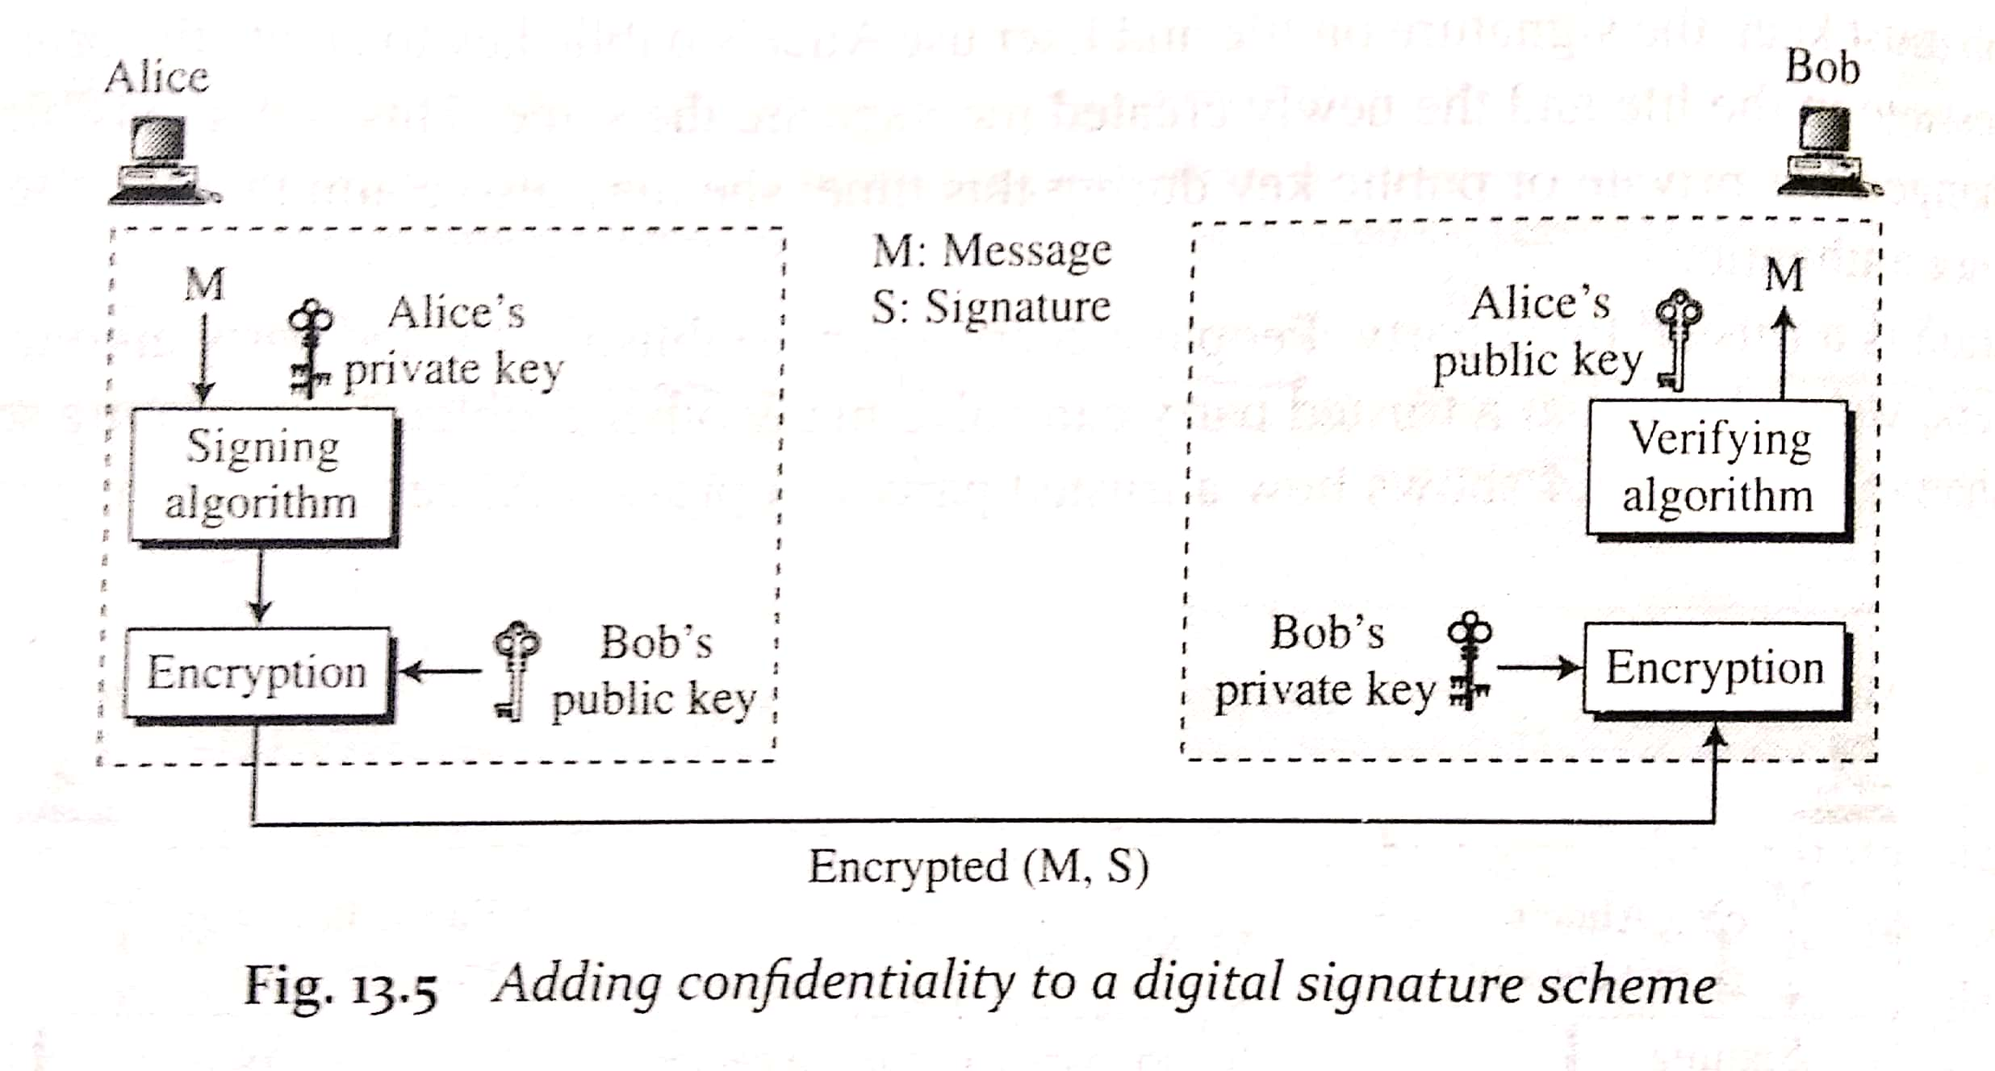
Confidentiality
.

Slide 22
Attacks on Digital Signature
Key Only Attack
Known Message attack
Chosen Message attack

Slide 23
Key-Only attack
Eve has access to the public information released by Alice
To forge a message, Eve needs to create signature of Alice to convince Bob that the message is coming from Alice
Known Message attack
Eve has access to documents previously signed by Alice
Eve tries to create another message and forge signature of Alice on it

Slide 24
Chosen Message attack
Chosen Message attack
Eve somehow makes Alice sign on more than one message for her
Eve now has a chosen message-signature pair
Eve later creates another message with the contents she wants and forges signature of Alice on it

Slide 25
Forgery Types
Existential: Eve may be able to create a valid message-signature pair but she can not really use it
Selective: Eve may be able to forge signature of Alice on a message with the content selectively chosen by Eve

Slide 26
RSA digital signature scheme
RSA can be used for signing and verifying a message
The private and public keys of the sender is used
The sender uses its own private key to sign the document and the receiver uses the sender’s public key to verify the document
RSA digital signature scheme changes the role of private and public key
Private key plays the role of the sender’s own signature
Sender’s public key plays the role of copy of the signature that is available to the public

Slide 27
RSA digital signature scheme
The signing and verifying uses the same function but with different parameters
The verifier compares the message and the output of the function for congruence.
If result is true, message is accepted

Slide 28
RSA digital signature scheme
Key Generation:
Same as RSA. Public key is(e,n) and Private Key is d
Signing and Verifying
Signing:-
Alice creates a signature of the message using her private exponent, S=M^{d} mod n
Alice sends this message and signature to Bob

Slide 29
RSA digital signature scheme
Verifying:-
Bob receives M and S
He applies public exponent of Alice to the signature to create a copy of the message M`=S^{e} mod n
Bob compares the value of M` with value of M
If the two values are congruent, then Bob accepts the message
The verification criteria used is:
M'Ξ M (mod n) S^{e}Ξ M (mod n) M^{dxe} Ξ M (mod n)

Slide 30
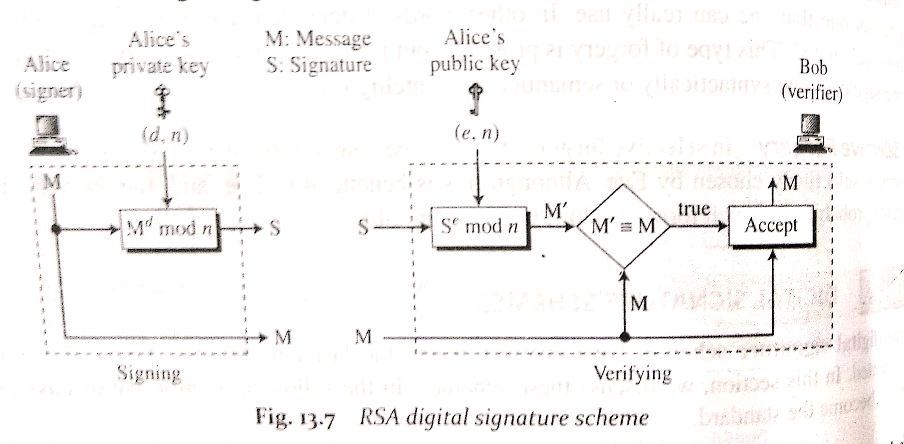
RSA digital signature scheme

